Slide 1
JNDI & Connection pooling

Slide 2

Objectives
At the end of this session, you will be able to,
  Describe architecture of JNDI
  Describe Connection Pool
  Demonstrate implementation of DataSource

Slide 3

Agenda
Following points to be covered in the session,
  JNDI Architecture
  Connection Pool
  Data Source implementation in JEE
CONFIDENTIAL© Copyright 2008 Tech Mahindra Limited

Slide 4
Overview of JNDI
The Java Naming and Directory Interface™ (JNDI) is an application programming interface (API) that provides naming and directory functionality to applications written using the Java™ programming language.
It is defined to be independent of any specific directory service implementation. Thus a variety of directories -new, emerging, and already deployed can be accessed in a common way.
A naming service maps developer friendly names to objects . So that the applications can access the same object with the bound name.

Slide 5
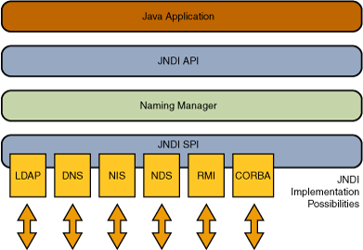
JNDI Architecture
The JNDI architecture consists of an API and a service provider interface (SPI). Java applications use the JNDI API to access a variety of naming and directory services.
The SPI enables a variety of naming and directory services to be plugged in transparently, thereby allowing the Java application using the JNDI API to access their services. See the following figure:
Notes:
Overview to Naming Service
A naming service maps developer friendly names to objects . So that the applications can access the same object with the bound name.
Names –To do the look up , one must know the name of object. The syntax of naming is determined by the naming service.It is known as the naming convention .
Bindings – The association between a name and an object is referred as binding .If an application need to access an object using a name then the object should bound to the name before.
Context – A context is a set of name to object bindings. The context provides the lookup. It also provides options to bind ,unbind and rebind objects .
InitilalContext –It is the starting point of all naming and directory operations.
Exceptions : JNDI defines a hierarchy of Exceptions . The super class is NamingExceptions. All other exceptions are deriving from NamingException.
The javax.naming package contains the classes and interfaces for accessing naming services.
Overview to DirectoryService
Similar to naming service here also it is possible to access objects with its name. In addition to this , it is possible to get the attributes of objects.Also it is possible to search for objects with attributes.
Directory and Directory Service
A directory is a connected set of directory objects.A directory service is a service which provides options for creating , adding ,removing and modifying attributes associated with directory.
There are many Directory service implementation available now a days. Examples are DNS(Domain Name System) and LDAP(Light weight Directory Access Protocol).In the coming sections we will be discussing various operations on directory services using JNDI. In all those examples , we will be taking LDAP as reference .
To use JNDI concepts in our application , we should have the naming classes along with at least one service providers. Java provides inbuilt support for:
a)Lightweight Directory Access Protocol (LDAP)
b)Common Object Request Broker Architecture (CORBA) Common Object Services (COS) name service
c)Java Remote Method Invocation (RMI) Registry

Slide 6
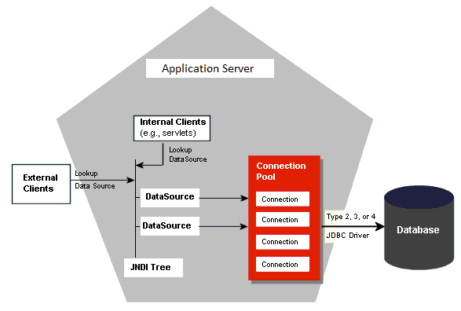
Connection Pool
As we have seen importance and need of connection pool in JDBC , lets see how we can implement it in server.
Notes:
Connection pooling has become the standard for middleware database drivers. The process of creating a connection, always an expensive, time-consuming operation, is multiplied in these environments where a large number of users are accessing the database in short, unconnected operations. Creating connections over and over in these environments is simply too expensive.

Slide 7
Connection Pool ( Cont.. )
A connection pool operates by performing the work of creating connections ahead of time, In the case of a JDBC connection pool, a pool of Connection objects is created at the time the application server (or some other server) starts.
These objects are then managed by a pool manager that disperses connections as they are requested by clients and returns them to the pool when it determines the client is finished with the Connection object.
When the connection pool server starts, it creates a predetermined number of Connection objects. A client application would then perform a JNDI lookup to retrieve a reference to a DataSource object that implements the ConnectionPoolDataSource interface. The client application would not need make any special provisions to use the pooled data source; the code would be no different from code written for a nonpooled DataSource.

Slide 8
Connection Pool ( Cont.. )
When the client application requests a connection from the ConnetionPoolDataSource, the data source implementation would retrieve a physical connection to the client application. The ConnectionPoolDataSource would return a Connection object that implemented the PooledConnection interface.
Notes:
The PooledConnection interface dictates the use of event listeners. These event listeners allow the connection pool manager to capture important connection events, such as attempts by the client application to close the connection. When the driver traps a close-connection event, it intercedes and performs a pseudo-close operation that merely takes the Connection object, returns it to the pool of available connection, and performs any housekeeping that is necessary.
The operation of the connection pool should be completely transparent to the client application. The triggering of connection events, the manipulation of the object pool, and the creation and destruction of physical connections are all managed by the pool manager. The activities of the connection pool are, however, configurable by the application developer or the application deployer

Slide 9
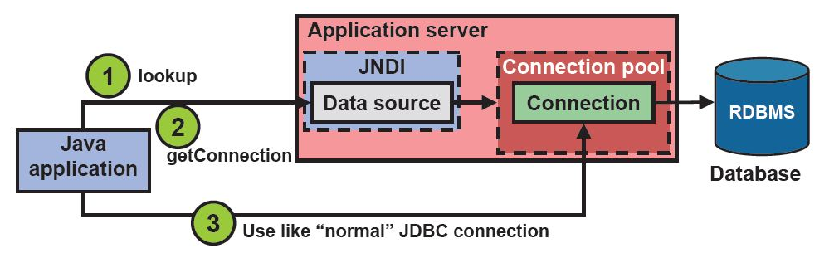
Data Source
When a request comes towards server the following way is used to process it.
Following diagram also shows relation between Data Source, JNDI and Connection Pool.

Slide 10
Data Source coding implementation
To implement JNDI and get a connection object from connection pool we need to write down following code in servlet instead of normal JDBC code
For using these APIs, do import javax.naming.InitialContext and javax.sql.DataSource in java code
This is JNDI name for lookup where config. details are stored.
Context initContext = new InitialContext();
// OR Context envContext = (Context) initContext.lookup(“datacource/myds");
DataSource ds = (DataSource) invContext.lookup(“datacource/myds");
Connection conn = ds.getConnection();

Slide 11

Summary
In this session, we have covered,
    JNDI
    Connection Pool
    Data Source Configuration
Notes:
Books :
Head First Servlets and JSP

Slide 12
Thank You

